Slide 1
Wireframe Guidelines
IT HUE Team
Dec 2016

Slide 2

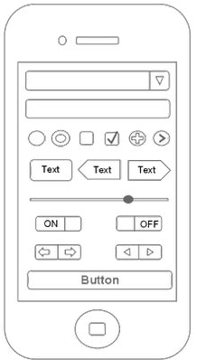
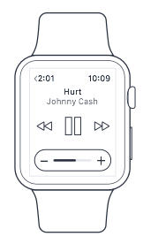
Wireframes
A wireframe is a two-dimensional illustration of a page’s interface that specifically focuses on space allocation and prioritization of content, functionalities available, and intended behaviors. For these reasons, wireframes typically do not include any styling, color, or graphics. Wireframes also help establish relationships between a website’s various templates.

Slide 3
Creating Wireframes
It’s important to keep in mind that wireframes are guides to where the major navigation and content elements of your site are going to appear on the page. Since the goal of the illustrations is not to depict visual design, keep it simple.
Do not use colors. If you would typically use color to distinguish items, instead rely on various gray tones to communicate the differences.
Do not use images. Images distract from the task at hand. To indicate where you intend to place an image and its size, you can instead use a rectangular box sized to dimension with an “x” through it.
Use only one generic font. Typography should not be a part of the wireframing discussion. Within the wireframes, however, you may still resize the font to indicate various headers and changes in the hierarchy of the text information on the page.

Slide 4
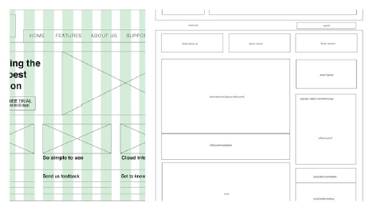
Fidelity Levels
Block Diagrams provide the most basic but essential information about a wireframe: the layout and types of content or functionality you would like to present to your visitors. You can also set the information hierarchy and typography in this stage by adding text and varying the sizes to show emphasis or hierarchy. Just make sure to set your grid ahead of time to stay structured and help you visually tie together the elements in the beginning stage.

Slide 5
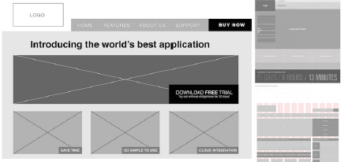
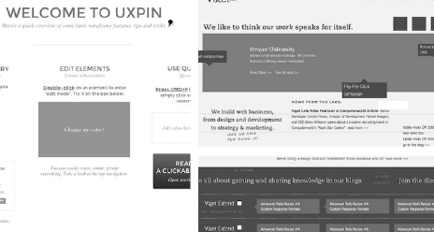
Fidelity Levels
Grey Boxes and High-Fidelity Text allow you use the full gray scale spectrum to emphasize the layout and particular elements without taking the time to choose a color palette or cluttering your wireframe. This may mean ﬁlling in the actual copy.

Slide 6
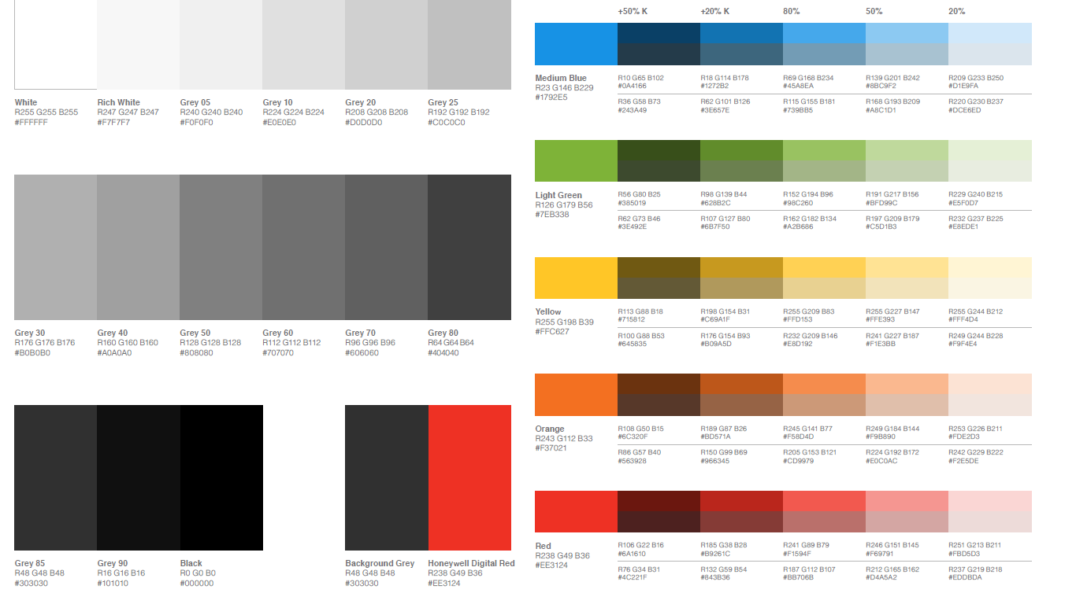
Wireframe Palette

Slide 7
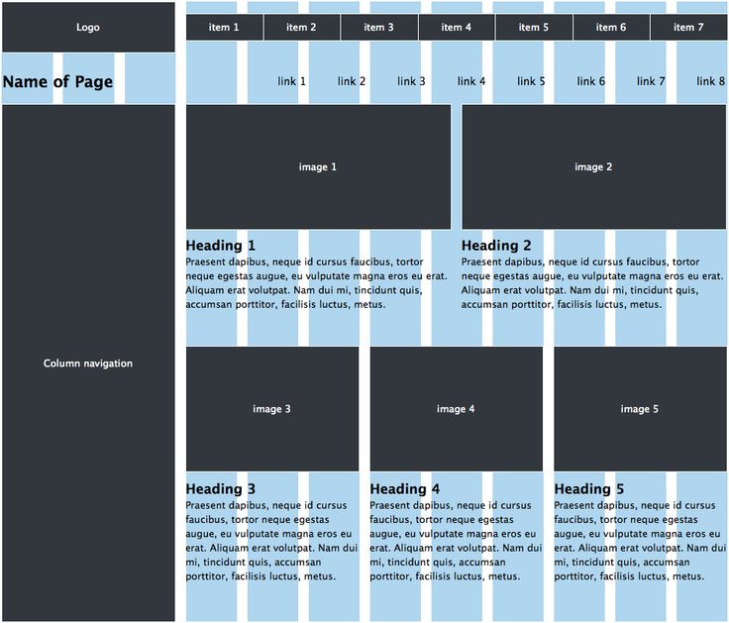
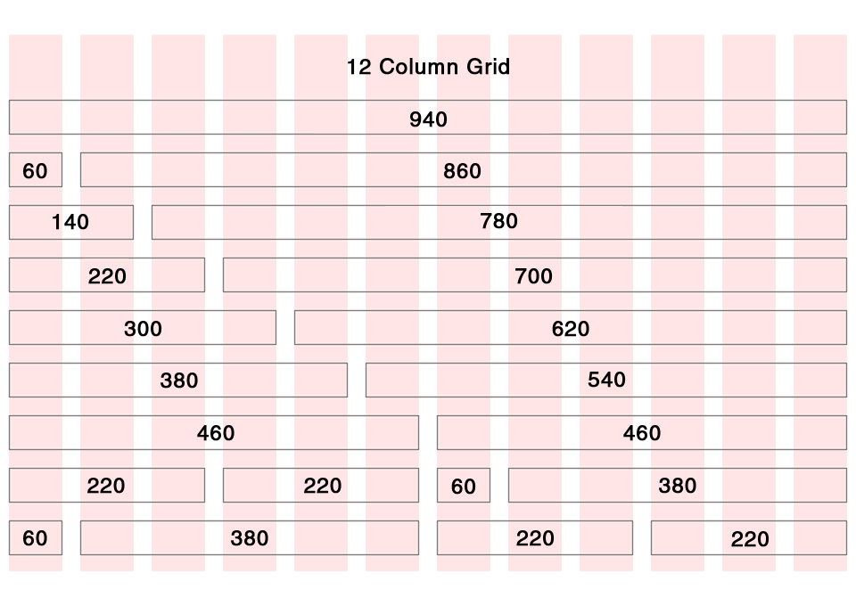
Grid - http://1200px.com/

Slide 8
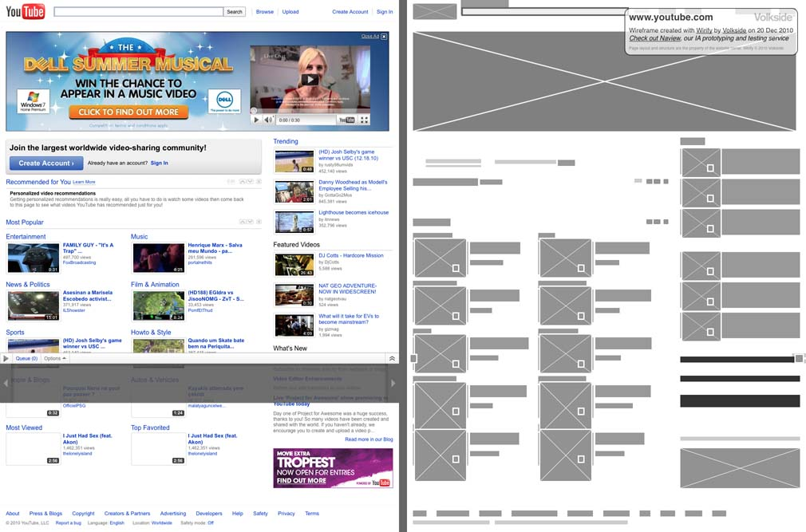
Design Based on Wireframe

Slide 9
References
http://www.usability.gov/how-to-and-tools/methods/wireframing.html
http://uxpin.e24files.com/uxpin_the_guide_to_wireframing.pdf

Slide 10
Thank You

